Slide 1

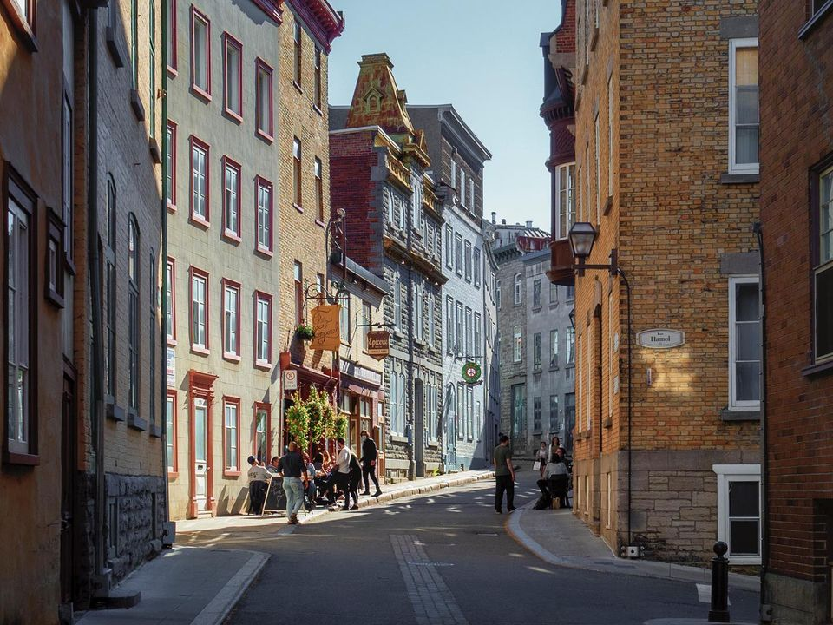

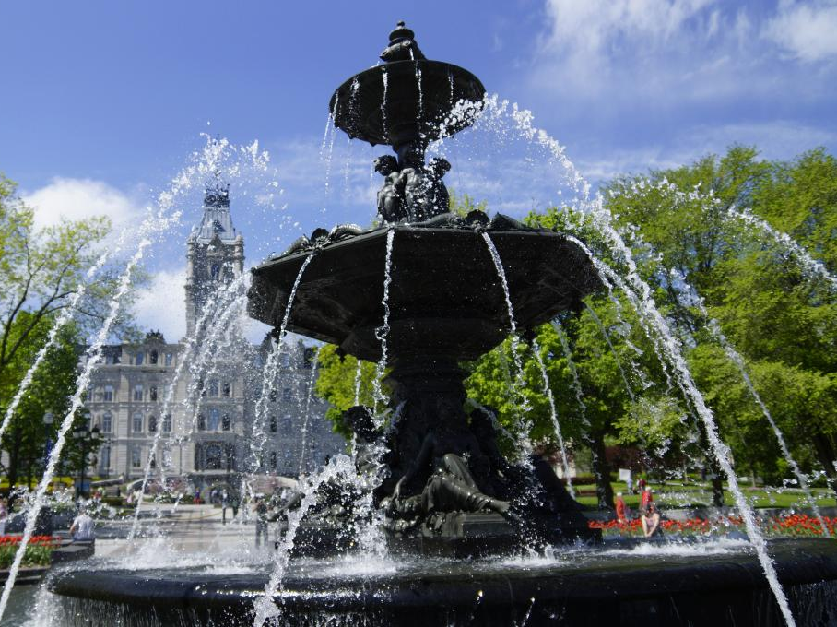

GSMS @ QC 2027

Slide 2
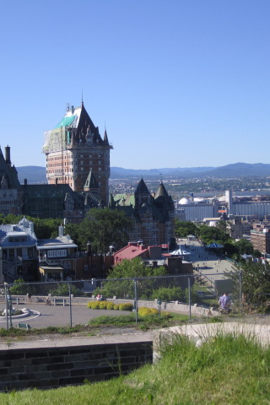
Who goes?
The trip is for all grade 8 students.

Slide 3
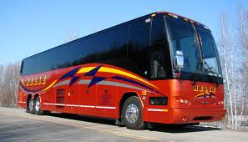

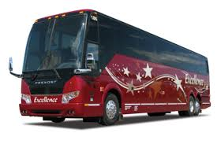
When is the trip?
Busses leave GSMS early on MONDAY June 21st, 2026 and will return on the evening of WEDNESDAY June 23rd.
Students will most likely be on the same bus as their hotel roommates.

Slide 4
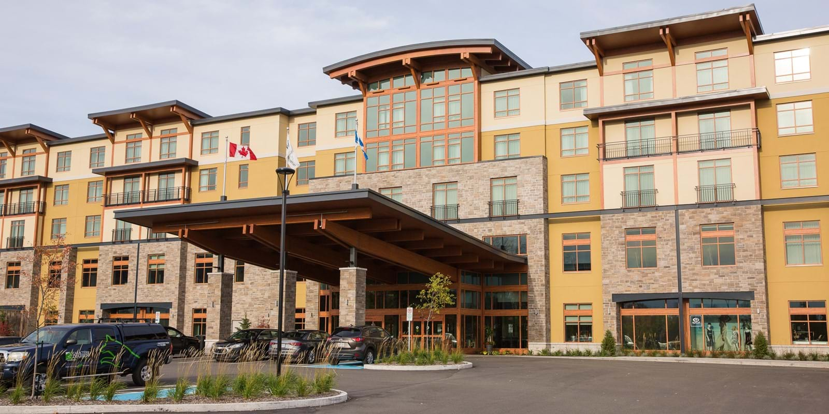

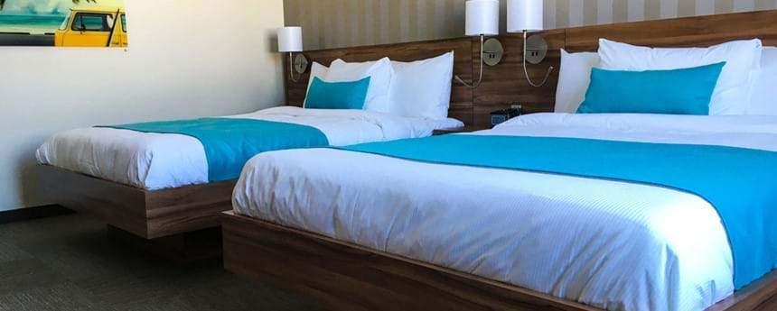
Where do students stay?
Students stay 4 to a room at Village Valcartier, a few minutes outside Old Quebec.
Room selections will be done a few weeks prior to the trip.

Slide 5

What do students do during the trip?
A walking tour of fortified Old Quebec City
+ Free time time to explore Old Quebec
A waterslide park experience (outdoor)
A visit to the Montmorency Falls
An exploration of Quebec aquarium
A party at the Cabane à Sucre
A boat cruise party

Slide 6

How much does the trip cost?
COST: 810$
This cost includes travel, lodging, all whole group organized activities, and some meals.
DEPOSIT: $210 (due October)
FINAL PAYMENT: $600 (due April 2nd)
SPENDING MONEY: 150$ suggested (lunches, 1 dinner, snacks, souvenirs)

Slide 7
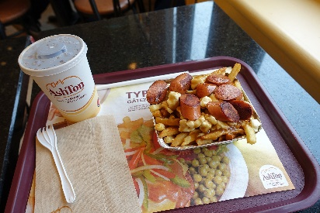


What is included in the cost?
Included
Not included
Transportation
Guides and chaperones
Hotel
Most meals
Access to attractions
3 lunches
-on the road to Quebec (day 1)
-at the waterpark (day 2)
-old Quebec (day 3)
1 dinner
-on the road, return trip (day 3)
Souvenirs, snacks, etc.

Slide 8
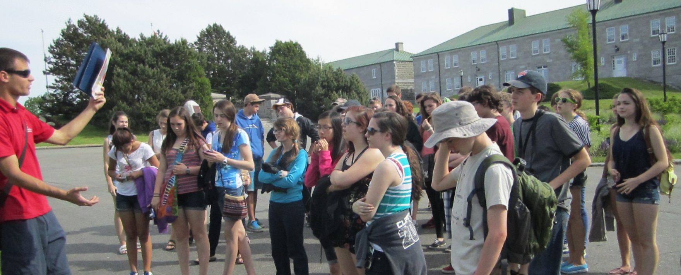
What are our expectations for students to be allowed on the trip?
Have regular attendance at school.
Be following regular school schedule.
Have displayed positive and responsible behaviour throughout the entire year.

Slide 9
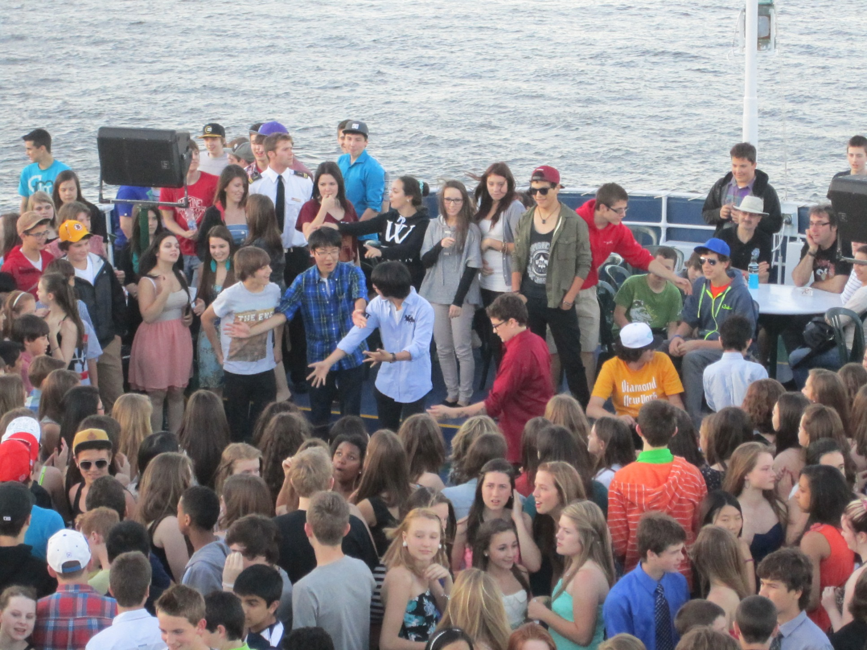
How can we help students participate? (Sponsorships)
In order to alleviate families with part of the cost (or travel expenses).
In order to sponsor one or a few students to allow them this unique oppportunity.
If you need sponsorship:
Come talk to us and see how we can arrange sponsorship.

Slide 10
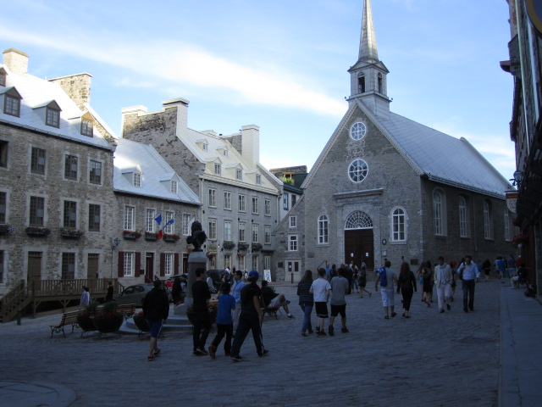
ACTION ITEMS
What forms and payments will need to be completed?
1) Permission form (here tonight, already sent email)
2) Deposit (210$) (due: October 30th)
3) Medical and allergies (May 1st, online)
4) Final payment (April 2nd)
5) Rooming choice (Early June)

Slide 11
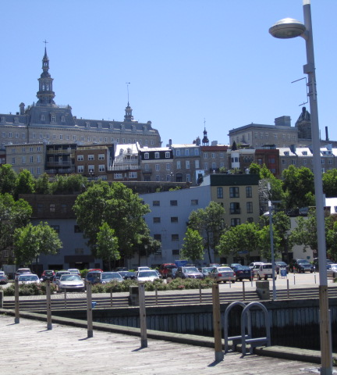
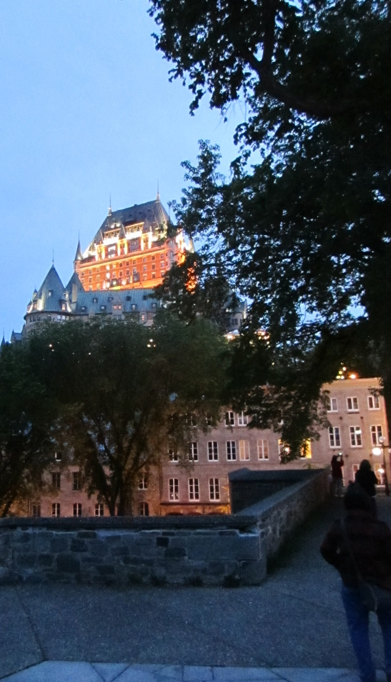
Any questions? Des questions?

Slide 12
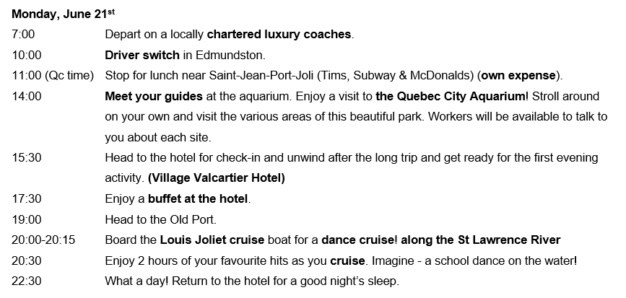

Slide 13
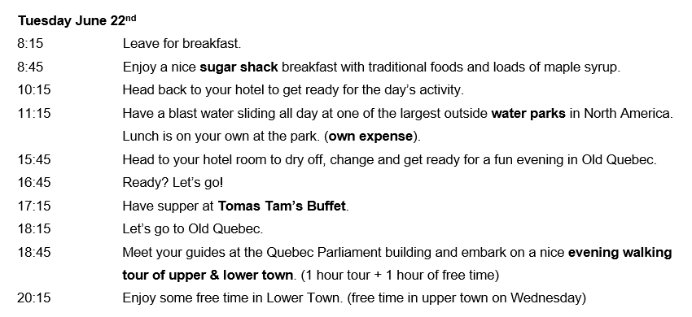

Slide 14
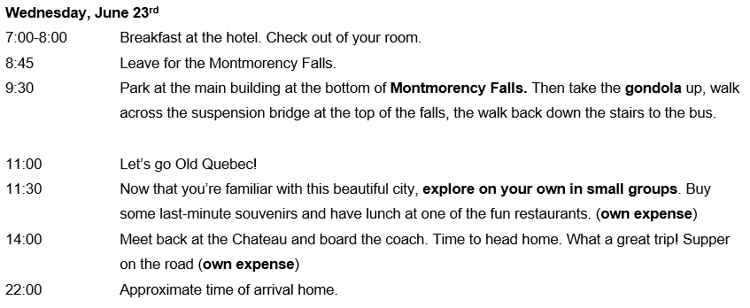



Slide 15
