Slide 1
Quebec City 2023

Slide 2
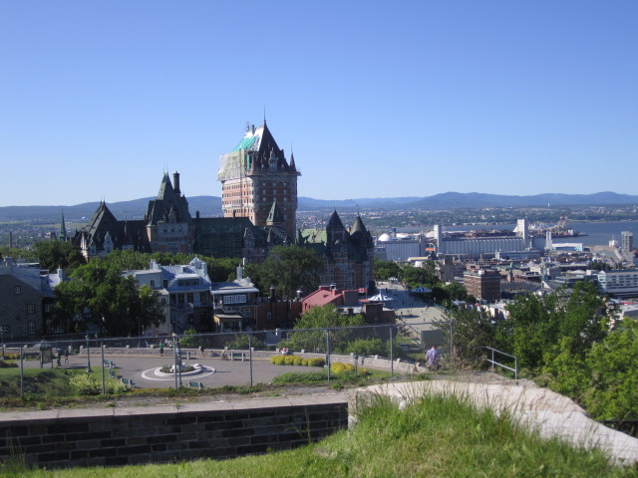

Slide 3
Who goes?
Grade 8 students who comply year long with all guidelines and rules associated with the trip are eligible to participate.

Slide 4
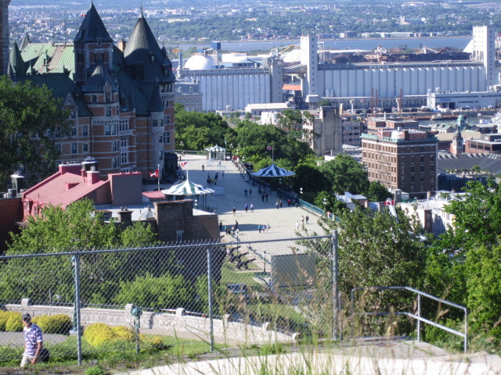

Slide 5
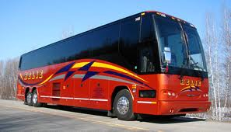
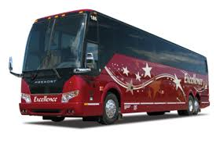
When is the trip?
Busses leave GSMS early on MONDAY June 17th, 2024 and will return on the evening of WEDNESDAY June 19th. Students will most likely be on the same bus as their hotel roommates.

Slide 7
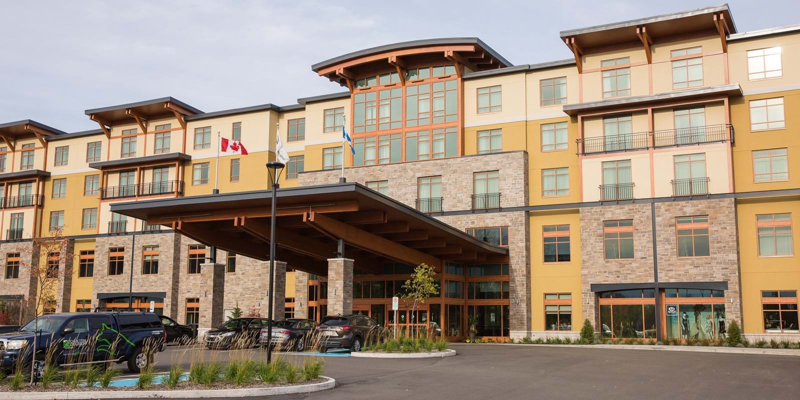
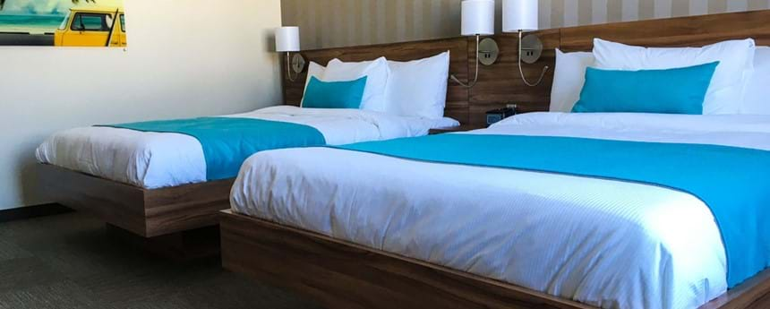
Where do students stay?
Students stay 4 to a room (rarely 6 to a suite) at Village Valcartier, a few minutes outside Old Quebec.
Room selections will be done a few weeks prior to the trip.

Slide 8
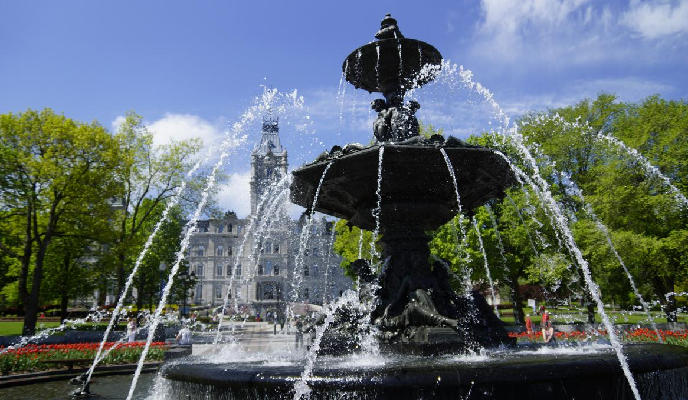
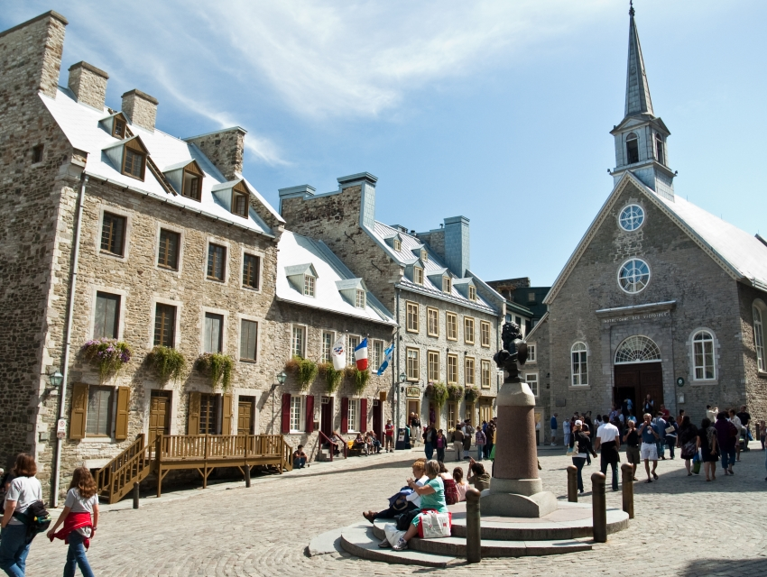
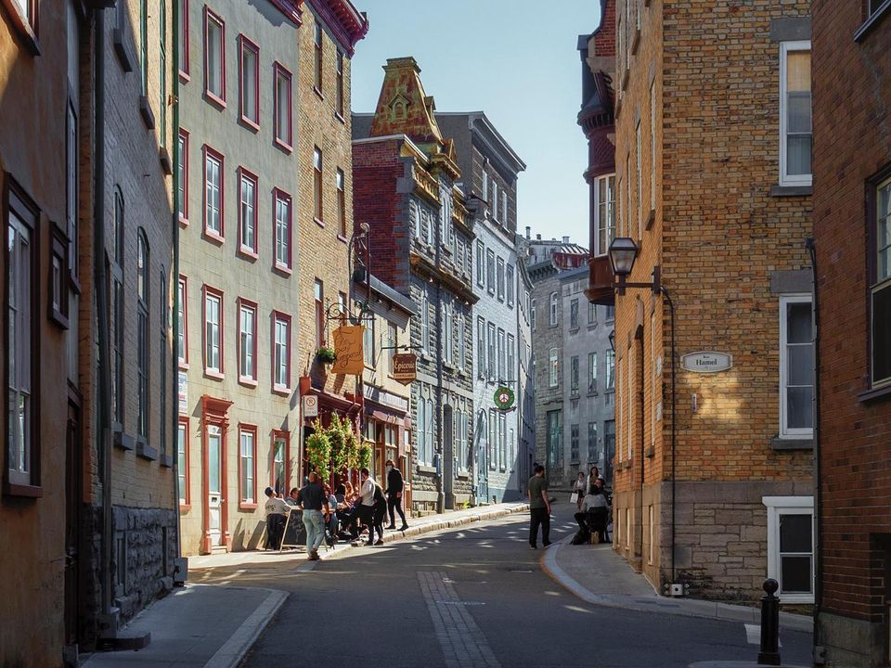
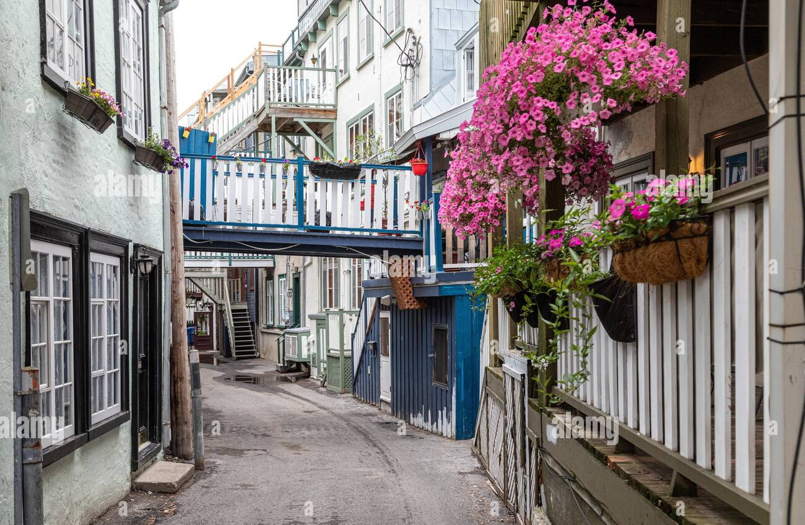

Slide 9
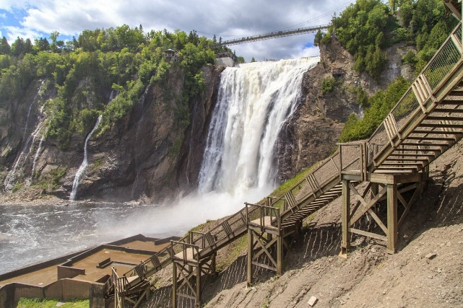
How much does the trip cost?
This year’s trip will cost around 680$. This cost includes travel, lodging, all whole group organized activities some meals.
A $150 deposit will be due October 20th. This deposit does not guarantee admission, this is subject to behaviour compliance.
150$ spending money and meals is encouraged

Slide 10
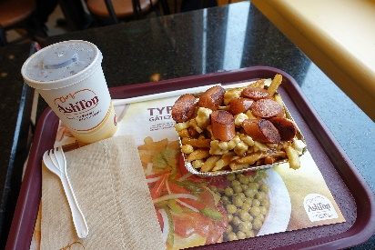
Inclusions
Included
Not included
Transportation
Guides and chaperones
Hotel
Most meals
Access to attractions
3 lunches
-on the road to Quebec (day 1)
-at the waterpark (day 2)
-old Quebec (day 3)
1 dinner
-on the road, return trip (day 3)
Souvenirs, snacks, etc.

Slide 11
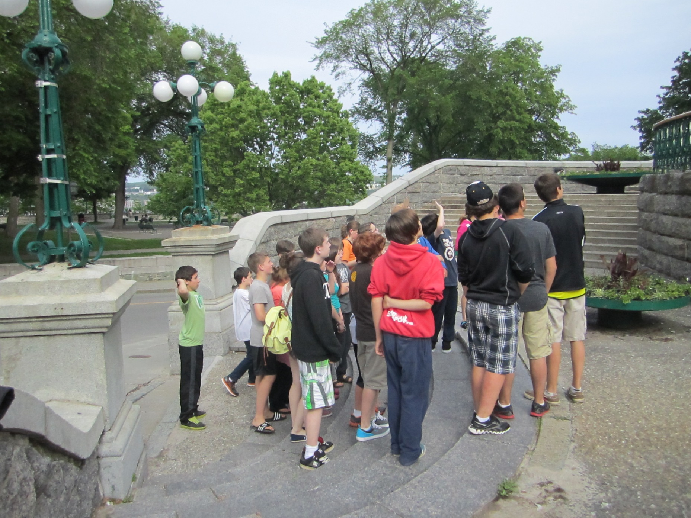

Slide 12
What do students do during the trip?
A walking tour of fortified Old Quebec City
+ Free time time to explore Old Quebec
A waterslide park experience (outdoor)
A visit to the Montmorency Falls
An exploration of Quebec aquarium
A party at the Cabane à Sucre
A boat cruise party

Slide 13
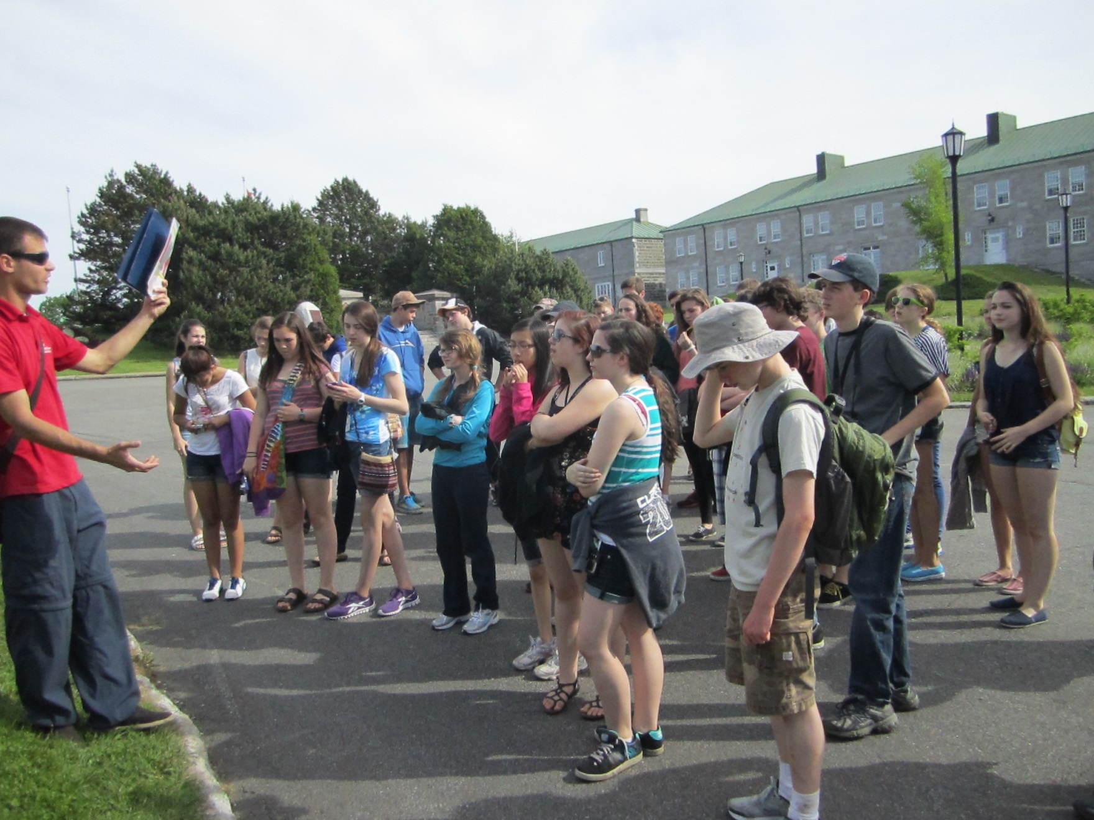

Slide 14
To be able to participate in this year’s Quebec Trip, students must meet the following criteria (in no particular order).
Have regular attendance at school.
Have no/few issues regarding consistent or incomplete work
Have displayed positive and responsable behaviour throughout the entire year

Slide 15
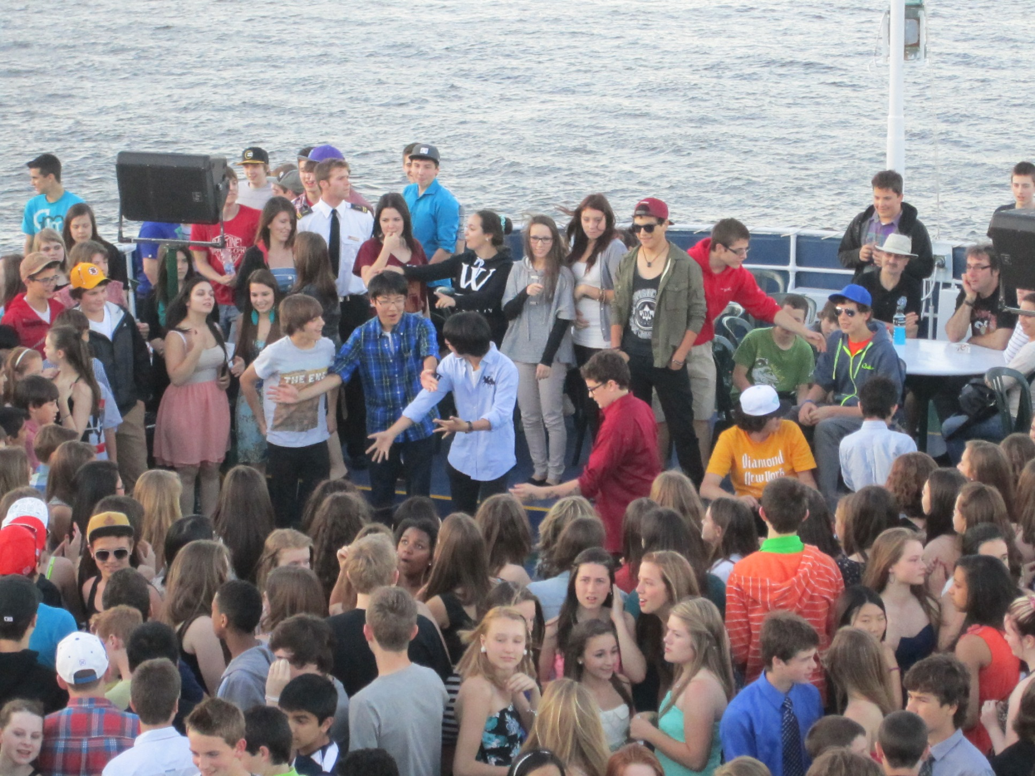

Slide 16
To be able to participate in this year’s Quebec Trip, students must…
1)Fill in the required paperwork (behavior contract, medical info) and have payed the two payments before deadlines.
2) What is the wait list?
3) Refund policy

Slide 17
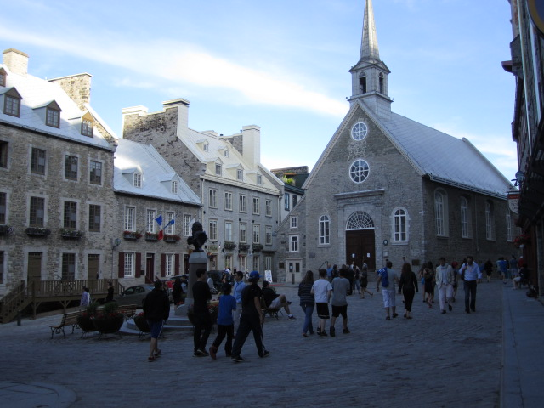

Slide 18
This trip is a privilege and not a right. The Quebec City Committee is looking to take students who are responsible, have demonstrated excellent work ethic and behaviour throughout the school. We want to take students who can be trusted at school and, therefore, outside of school. We thank you for your support with regards to the Quebec City organizing team’s decisions.

Slide 19
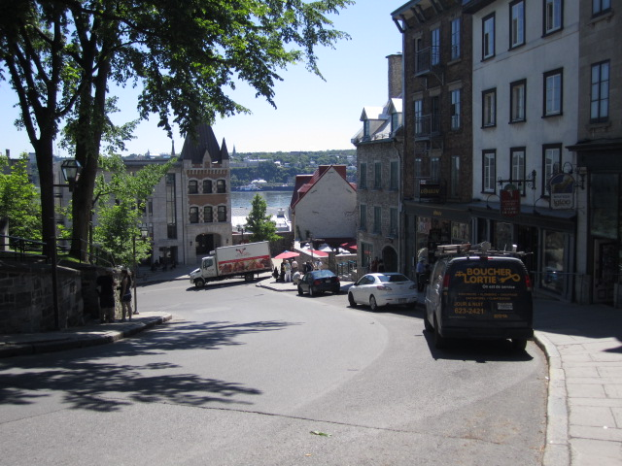

Slide 20
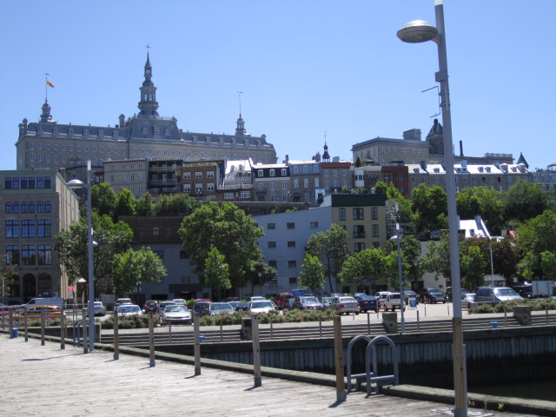
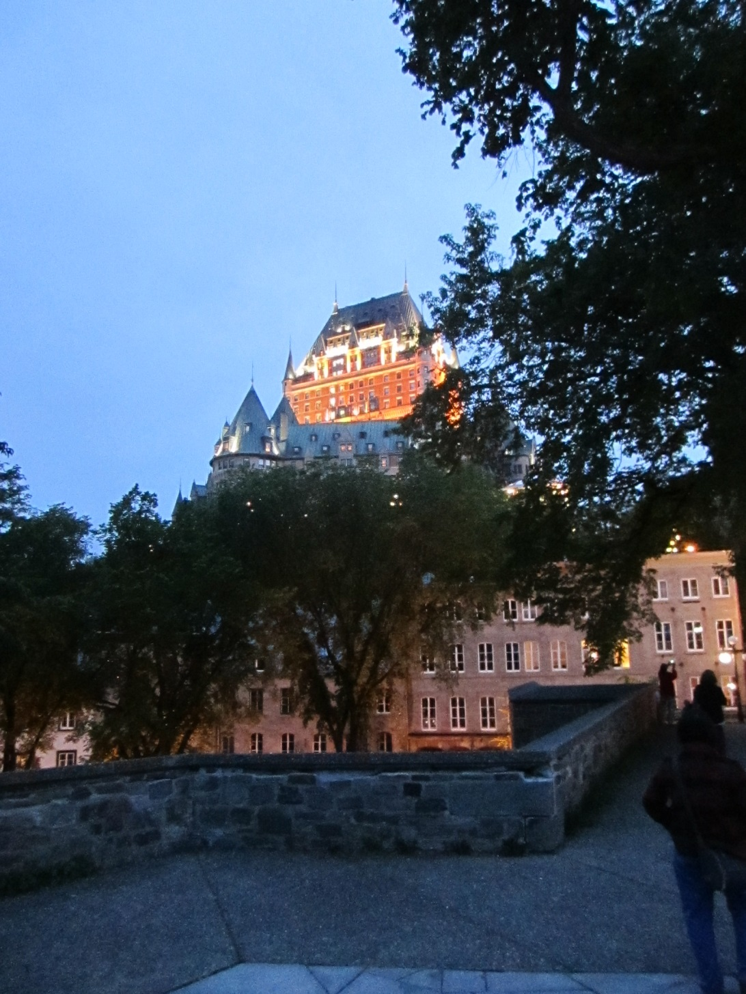
Any questions? Des questions?

Slide 21
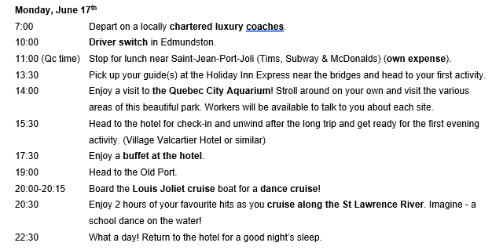

Slide 22
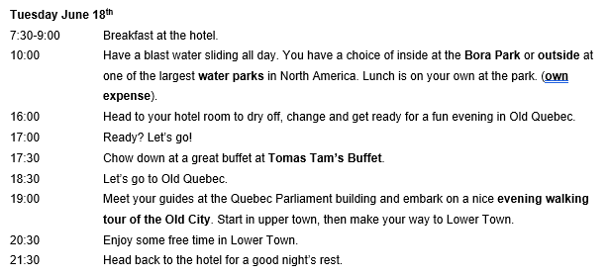

Slide 23
